Slide 1
Agenda
Gateway & gRPC Basics
Introduction to Spring Cloud Gateway
Key Features of Spring Cloud Gateway
Spring Cloud Gateway Benefits
Introduction to gRPC
gRPC Architecture and Core Concepts
Benefits of gRPC for Microservices
Gateway & gRPC Integration

Slide 2
Introduction to Spring Cloud Gateway

Slide 3
What is Spring Cloud Gateway?
Spring Cloud Gateway is a gateway service built on Spring Framework.
It acts as a reverse proxy to route client requests to backend microservices.
Specifically Built for Cloud-Native API Gateway Patterns.
Supports routing, filtering, and security out of the box.

Slide 4
Key Features of Spring Cloud Gateway

Slide 5
Key Features of Spring Cloud Gateway
Dynamic Routing: Routes incoming requests by URI, headers, etc.
Filters: Modify incoming requests and responses (auth, logging).
Load Balancing: Integrates with service discovery tools like Eureka.
Circuit Breaker: Provides fault tolerance for service failures.
Rate Limiting: Controls request rates to protect backend services.

Slide 6
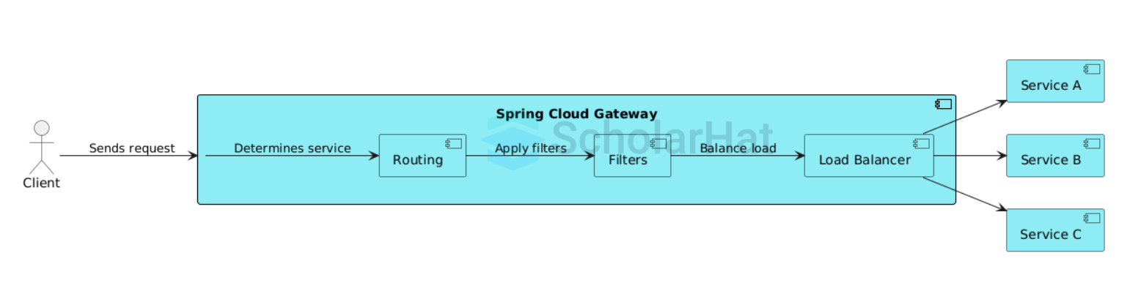
Gateway-Based Microservices Architecture

Slide 7
Benefits & Use Cases of Spring Cloud Gateway

Slide 8
Benefits & Use Cases of Spring Cloud Gateway
Centralized entry point for microservices APIs.
Simplifies security management (e.g., OAuth2 integration).
Improves monitoring and logging of API calls.
Enables request transformation and validation.
Ideal for cloud-native architectures needing flexible routing.

Slide 9
Introduction to gRPC

Slide 10
What is gRPC?
gRPC is a high-performance RPC framework by Google.
Uses HTTP/2 for multiplexing and streaming.
Uses Protocol Buffers for fast serialization.
Designed for low-latency, scalable microservices communication.

Slide 11
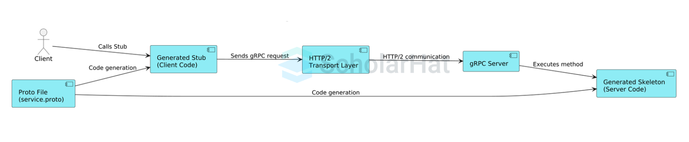
gRPC Communication Architecture

Slide 12
gRPC Architecture & Core Concepts

Slide 13
gRPC Architecture & Concepts
Service is defined in .proto files using Protocol Buffers.
Automatically generates client and server code in multiple languages.
Supports unary and all streaming communication types.
Uses HTTP/2 for efficient multiplexed connection transport.
Supports SSL/TLS, token-based authentication, and interceptors.

Slide 14
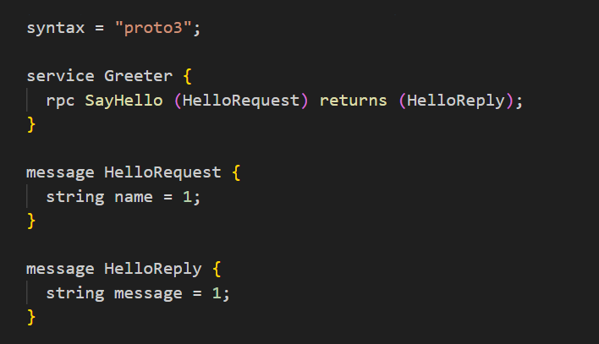
gRPC Architecture & Concepts

Slide 15
Benefits of gRPC for Microservices

Slide 16
Benefits of gRPC for Microservices
Performance: Low latency and smaller payloads due to binary serialization.
Cross-language: Supports many programming languages.
Streaming: Enables real-time communication with streaming APIs.
Strongly Typed Contracts: Proto files enforce strict API contracts.
Easy to scale: Works well with service meshes like Istio.

Slide 17
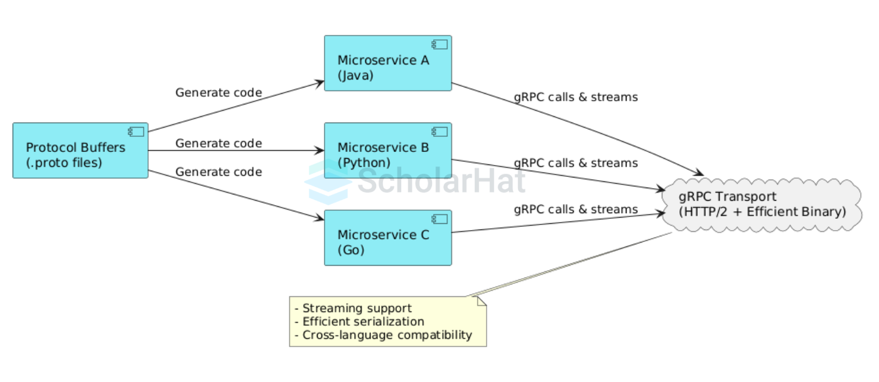
Multilingual Microservices with gRPC

Slide 18
Integrating Spring Cloud Gateway & gRPC

Slide 19
When to Use Spring Cloud Gateway & gRPC Together?
Use Spring Cloud Gateway as external API gateway for routing and security.
Use gRPC internally for fast and efficient microservices communication.
Gateway handles HTTP/REST clients and routes to backend services.
Backend services communicate using high-performance gRPC protocol.
Enables a hybrid microservices architecture leveraging both technologies.

Slide 20
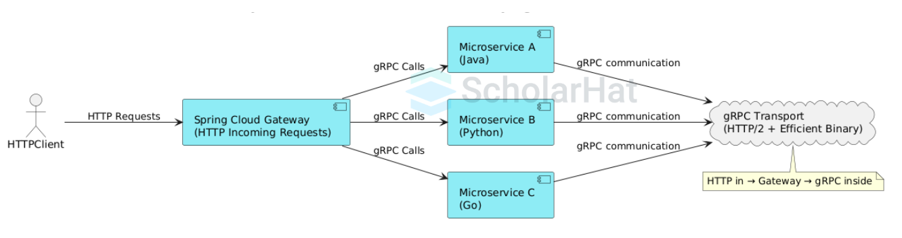
Hybrid Gateway and gRPC Architecture

